Slide 1

KMK DATABASE & SYSTEM
Sit Dolor Amet

Slide 2


CURRENT SYSTEM
NOTION
GOOGLE SHEET

Slide 3
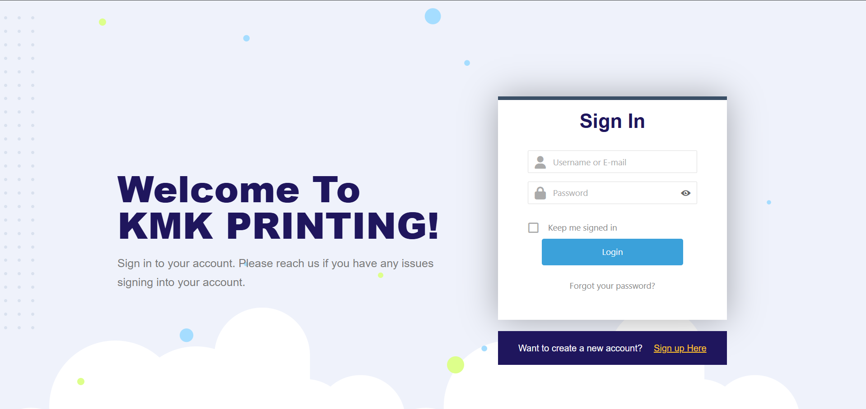
KMK SYSTEM

Slide 4
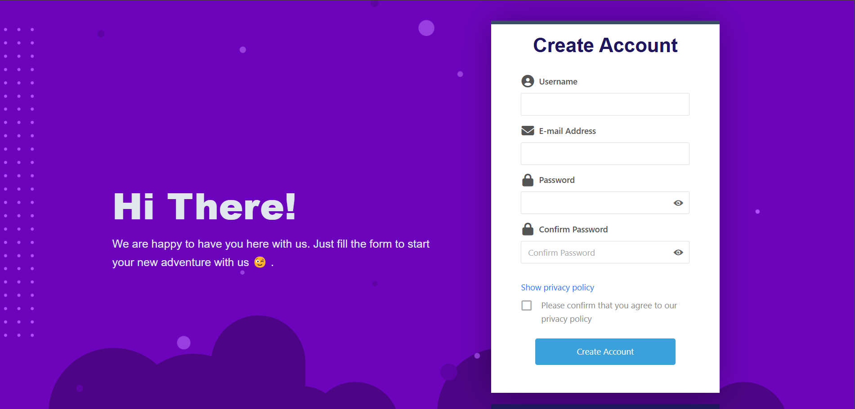
LOG IN & SIGN UP SYSTEM

Slide 5
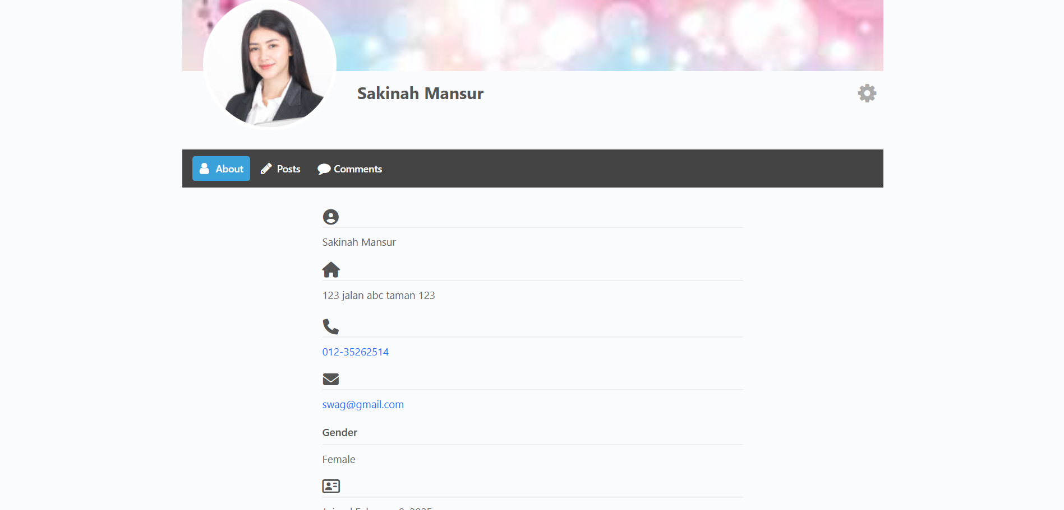
STAFF PROFILE

Slide 6
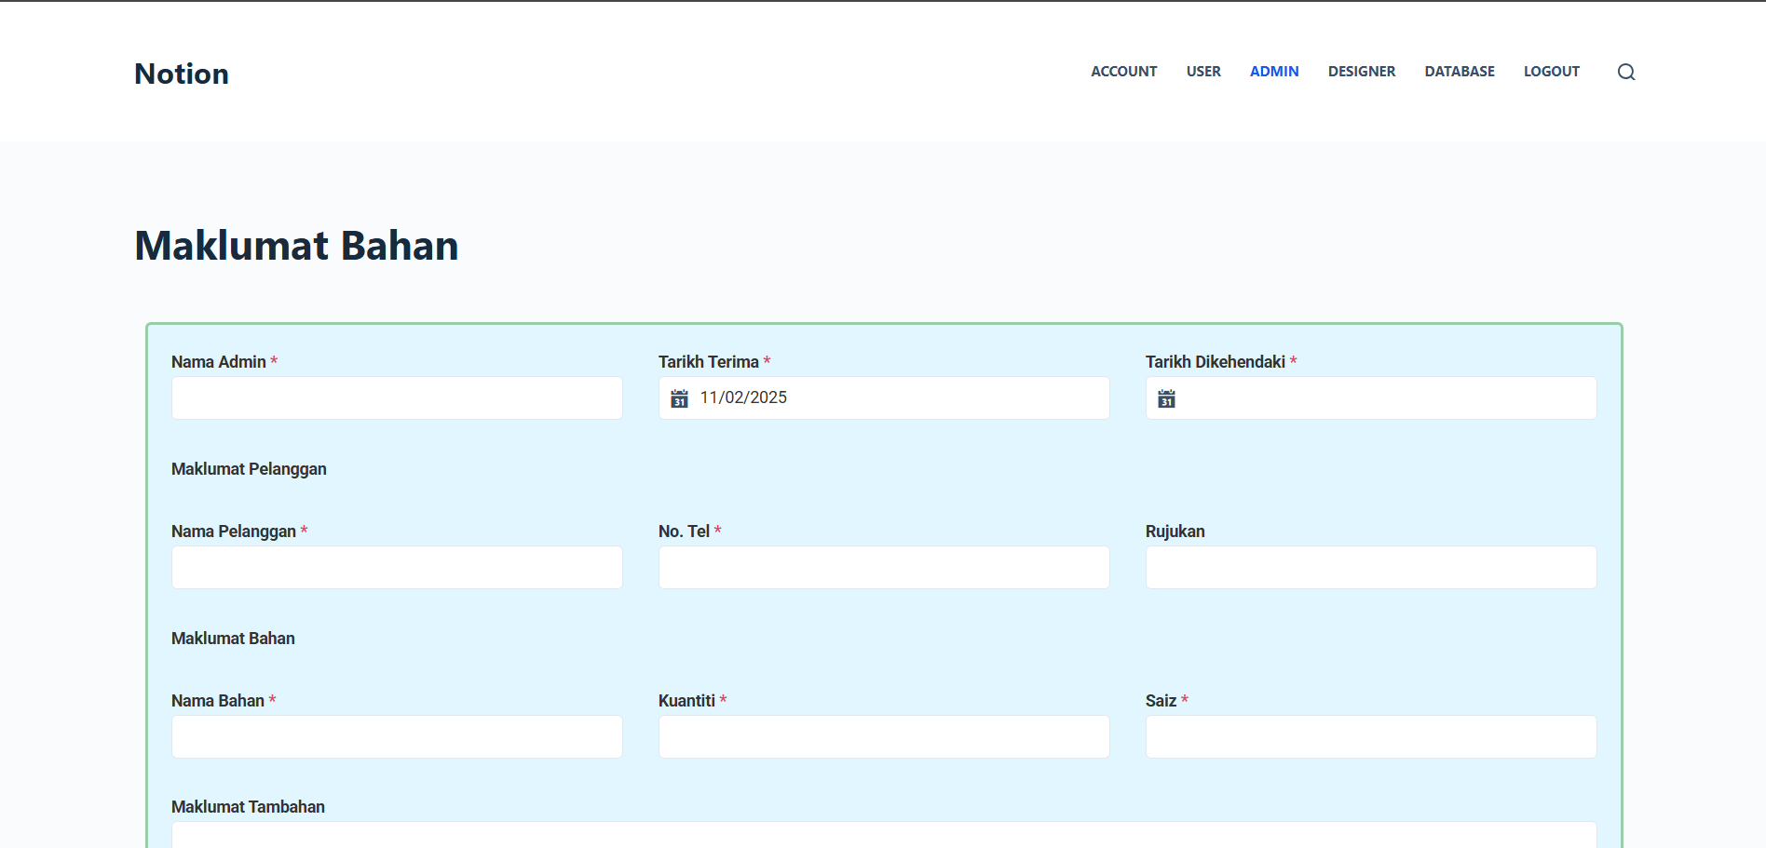
JOBSHEET

Slide 7
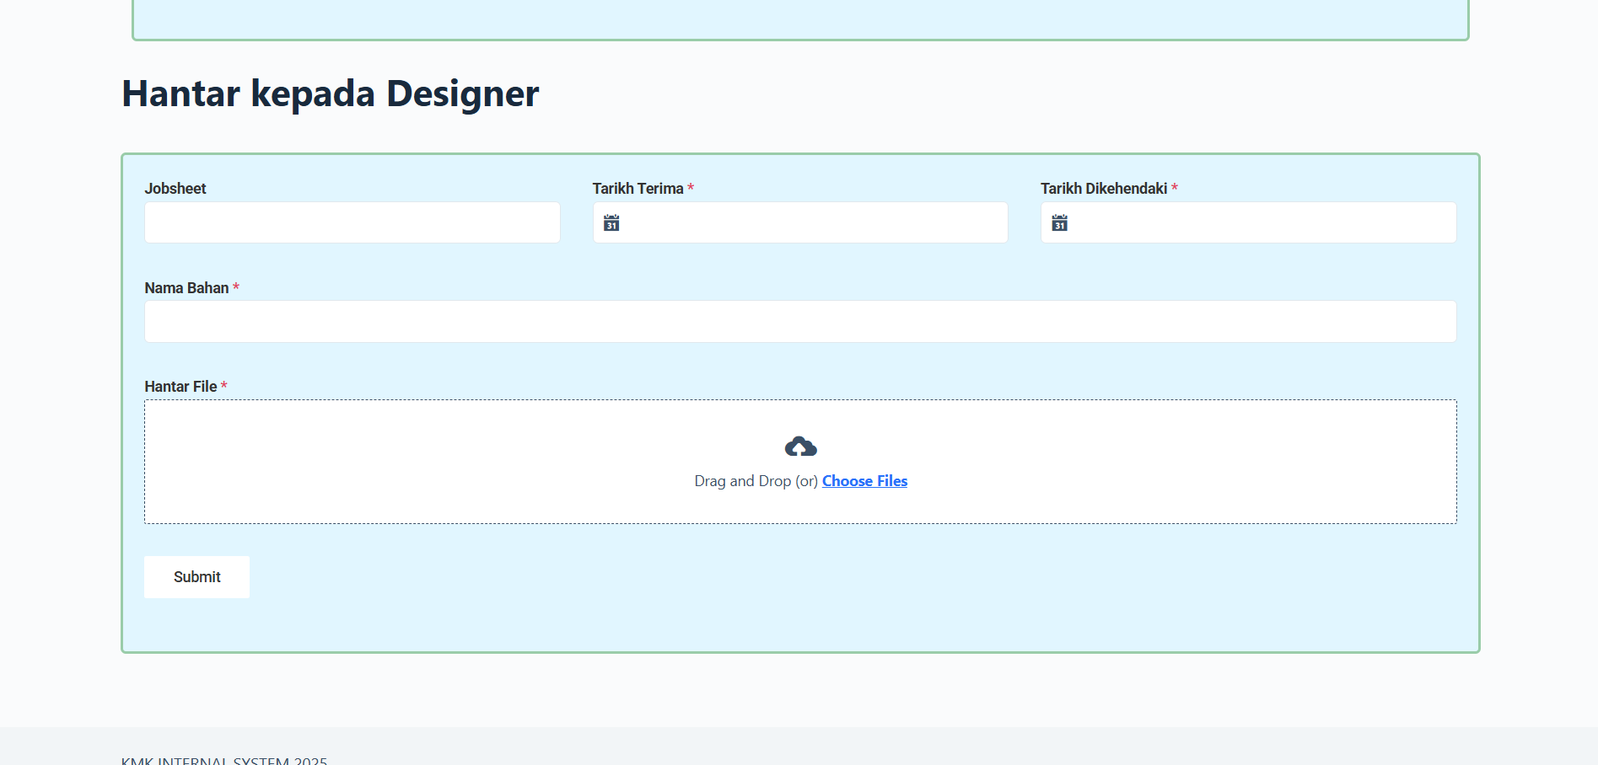
SEND KE DSESIGNER

Slide 8
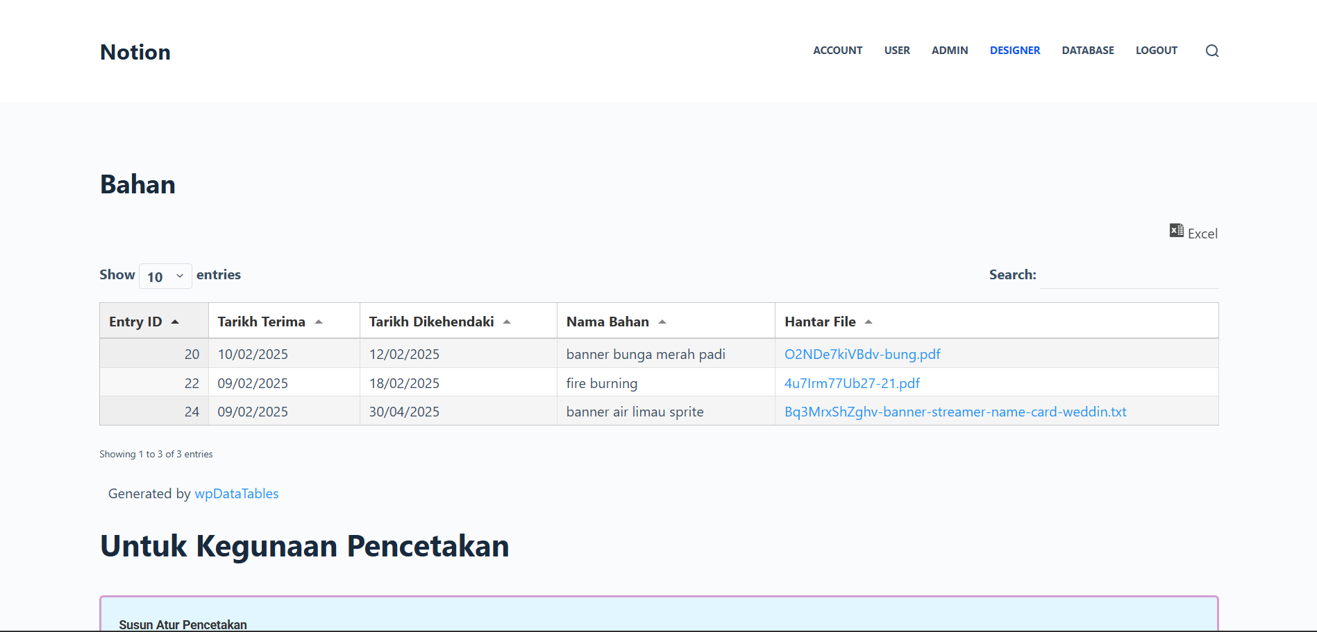
INFO BAHAN

Slide 9
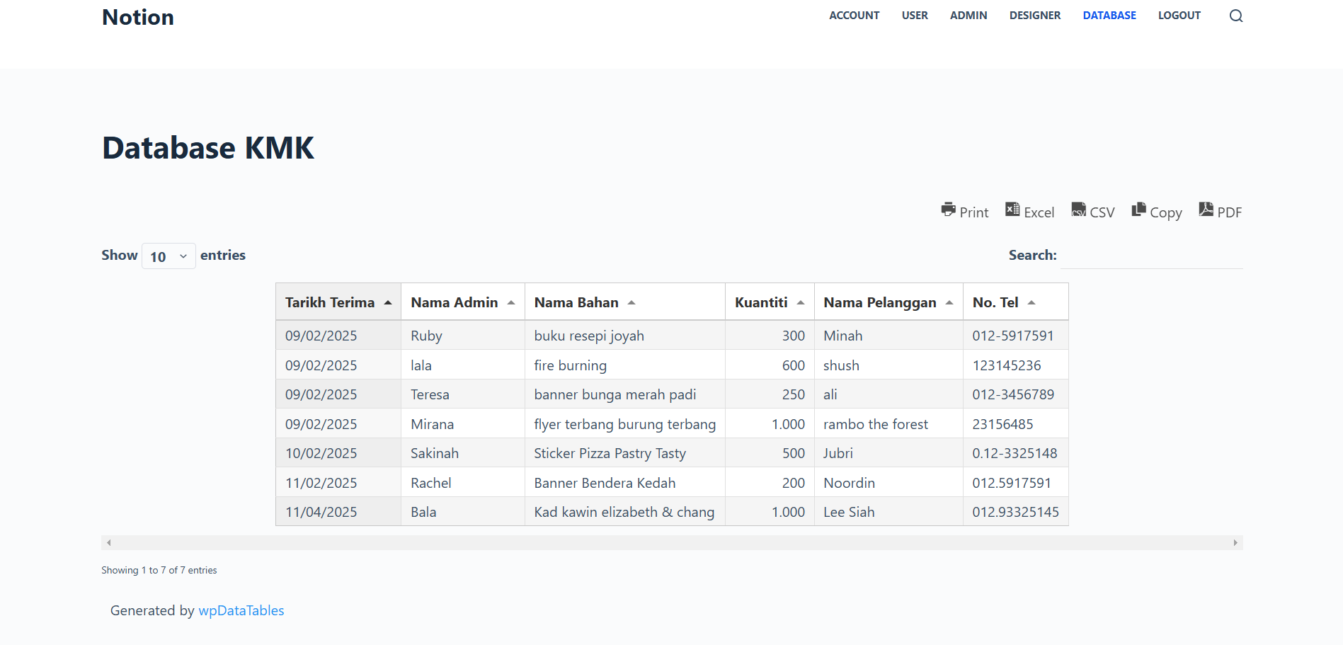
DATABASE FRONT END

Slide 10
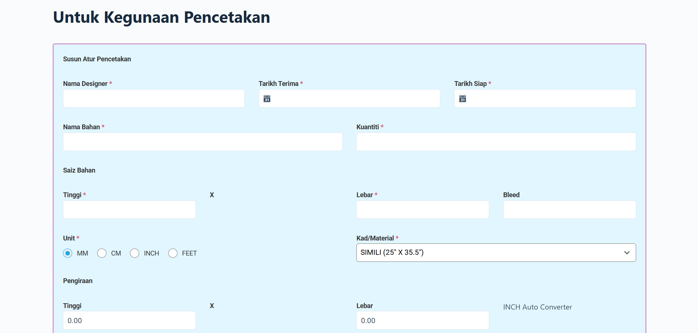
AUTO CALCULATE UP & KEPING

