Slide 1

WEBSITE PRESENTATION
BY MEGAT

Slide 2
DATABASE? NOTION?
GOOGLE SHEET?

Slide 3
PENGENALAN

Slide 4
KELEBIHAN
Kemudahan Pelanggan
Akses Kepada Pelawat
Pengiklanan
Akses Kepada Maklumat
Peluang Membuktikan Kredibiliti

Slide 5
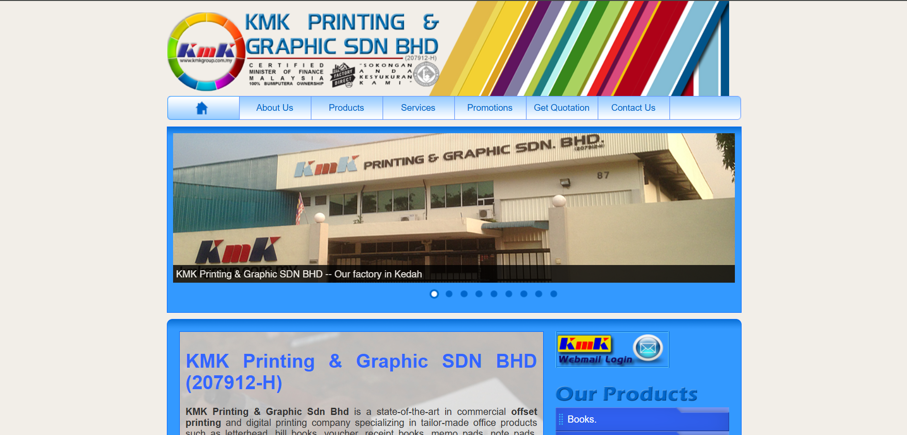
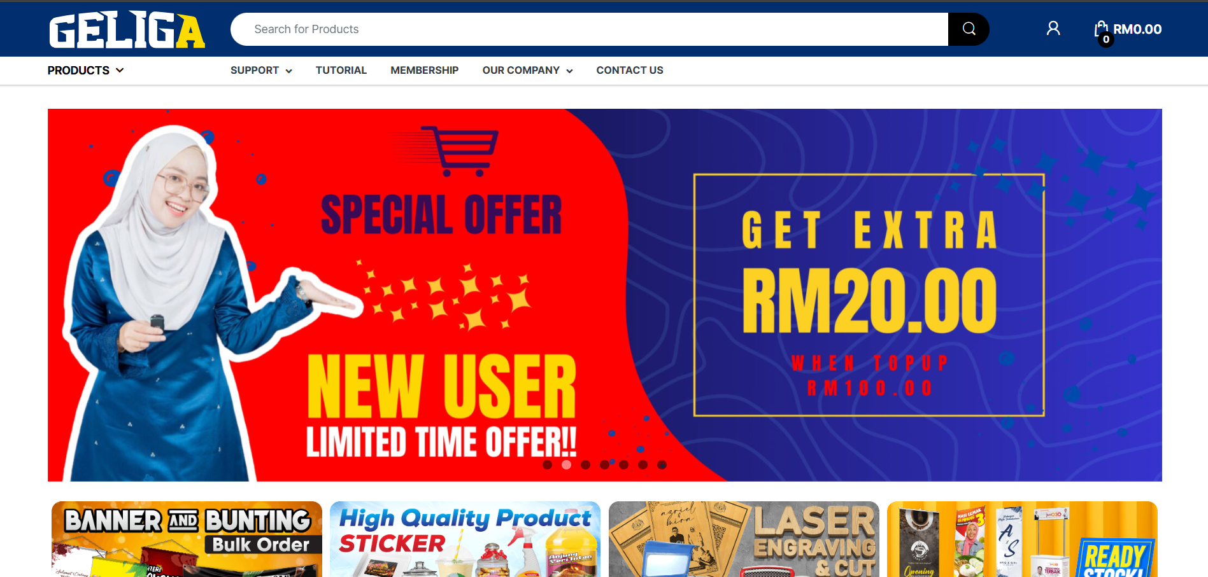
PERBEZAAN
WEBSITE KMK SEKARANG
WEBSITE COMPETITOR

Slide 6
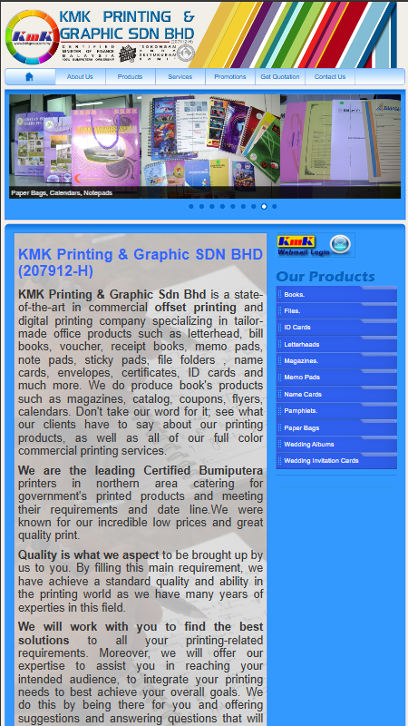
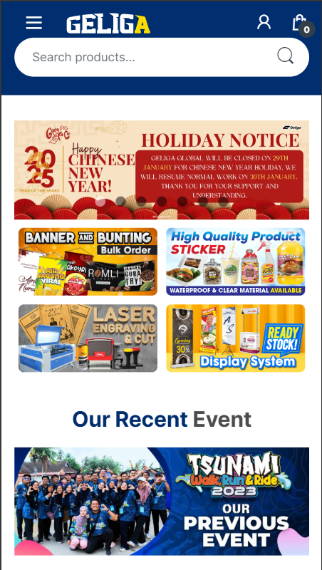
RESPONSIVE
NOT MOBILE RESPONSIVE
MOBILE RESPONSIVE

Slide 7
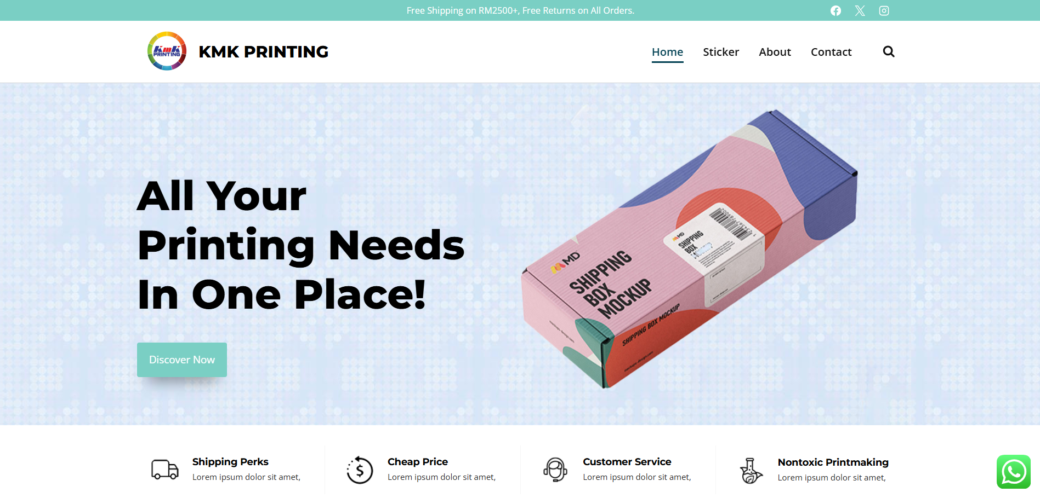
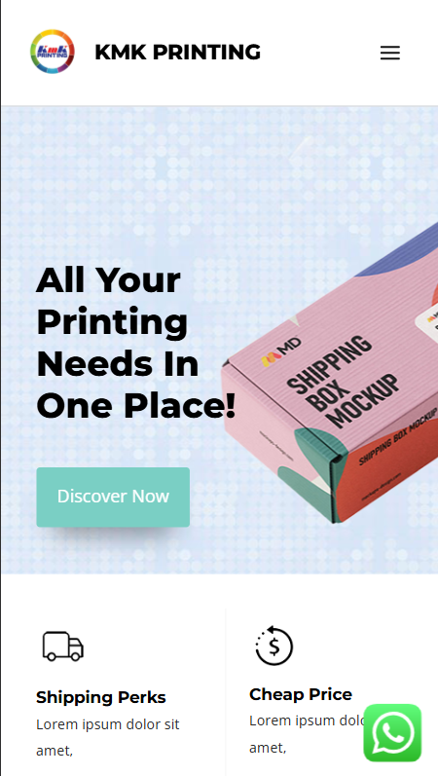
DEMO
www.kmkprinting.megathilmy.com

Slide 8
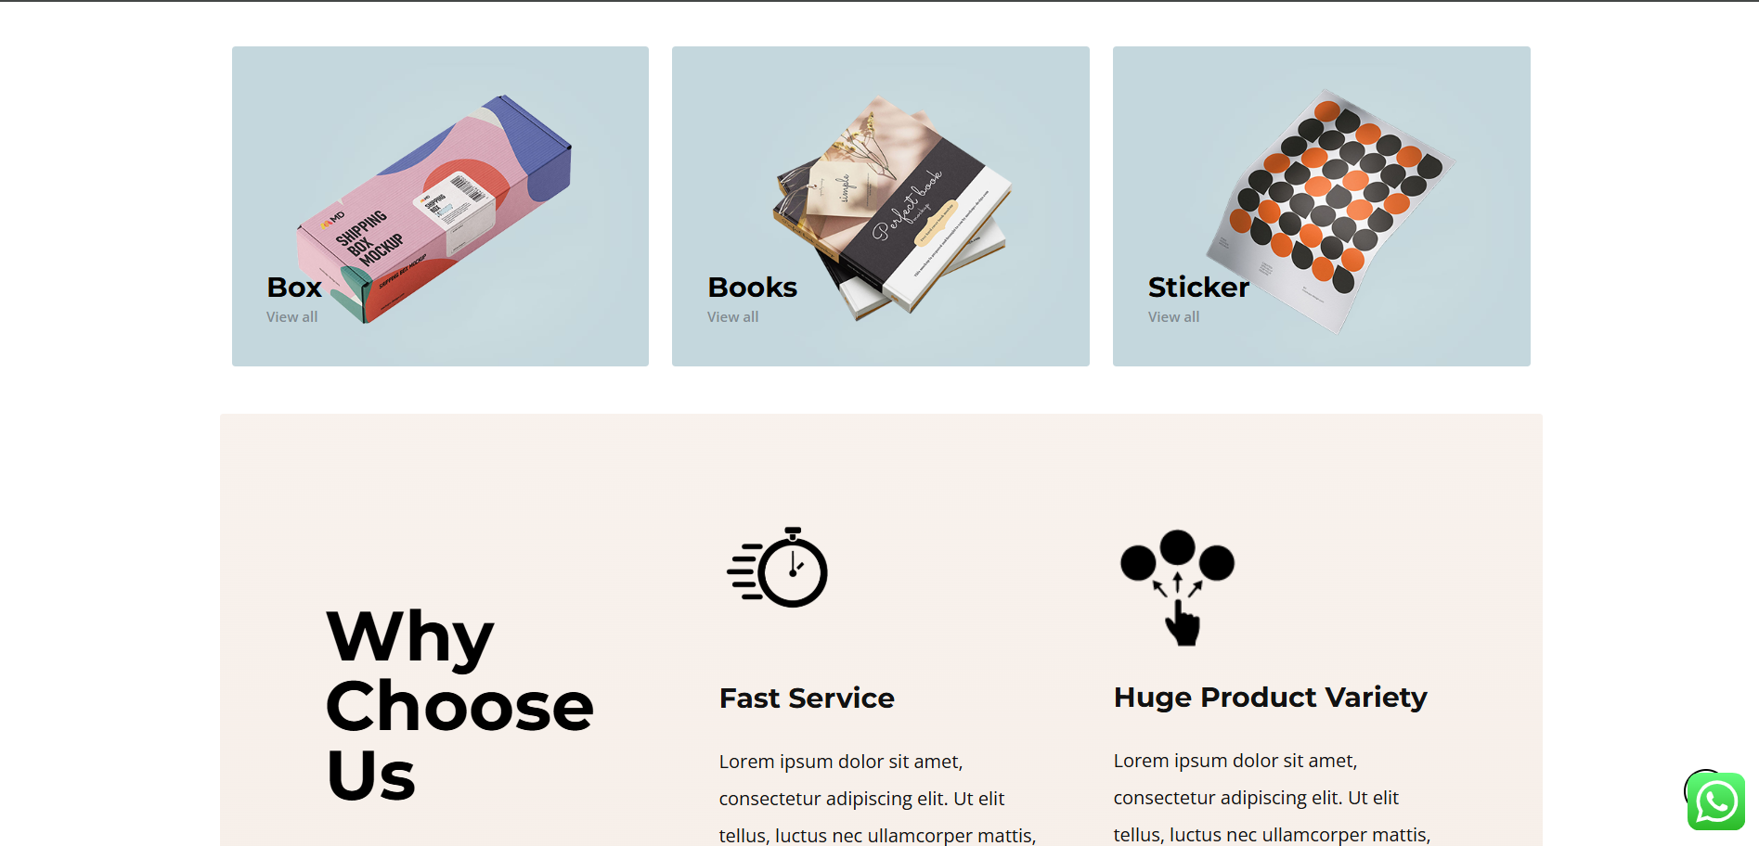
FRONT PAGE

Slide 9
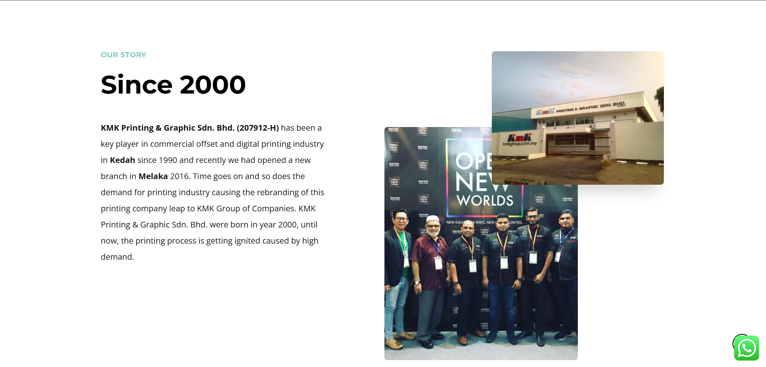
ABOUT US

Slide 10
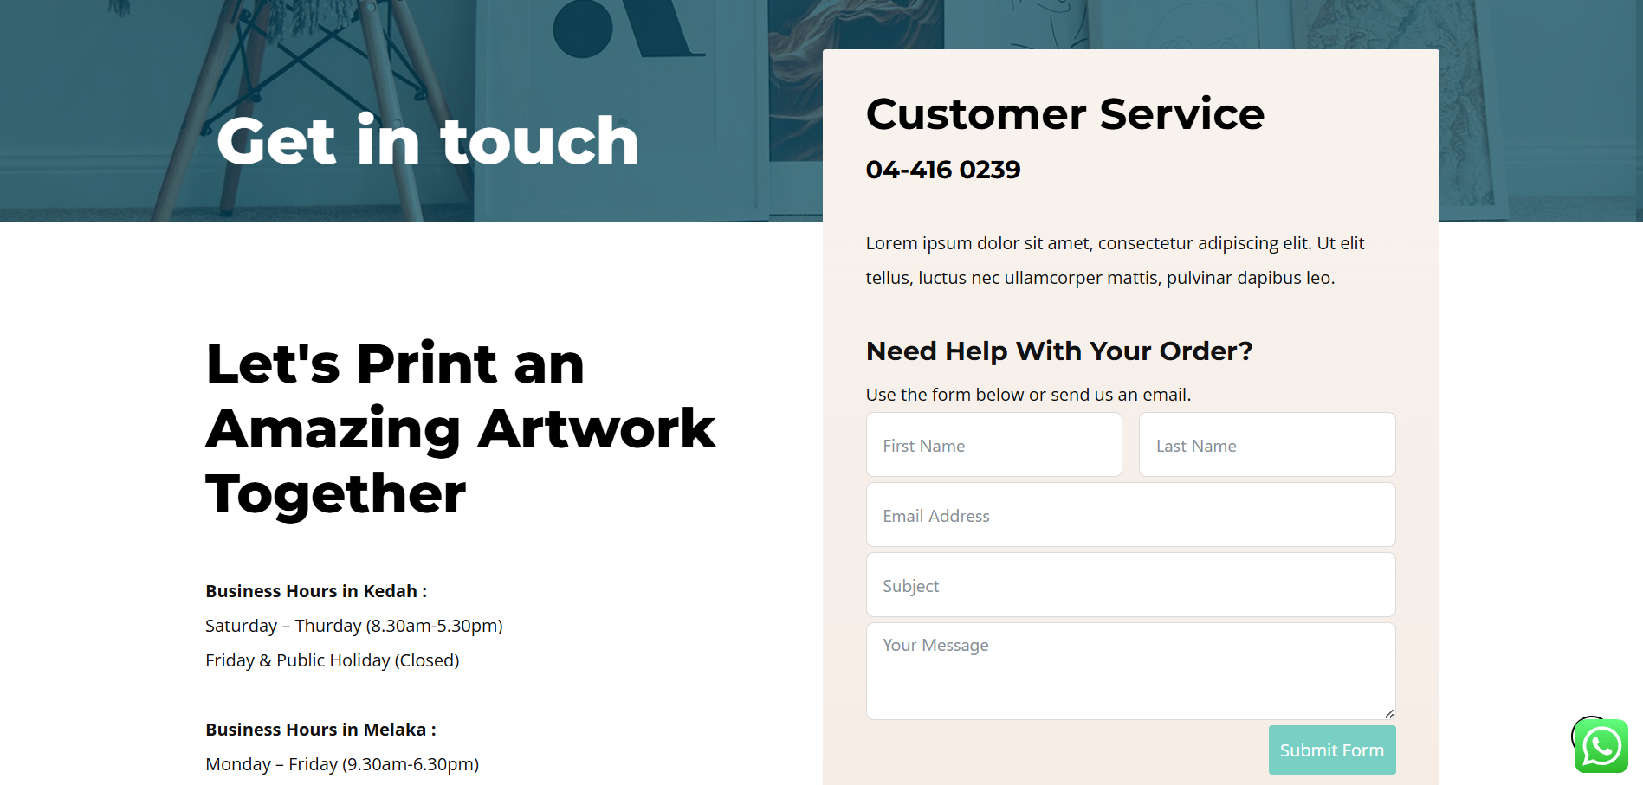
CONTACT US

Slide 11
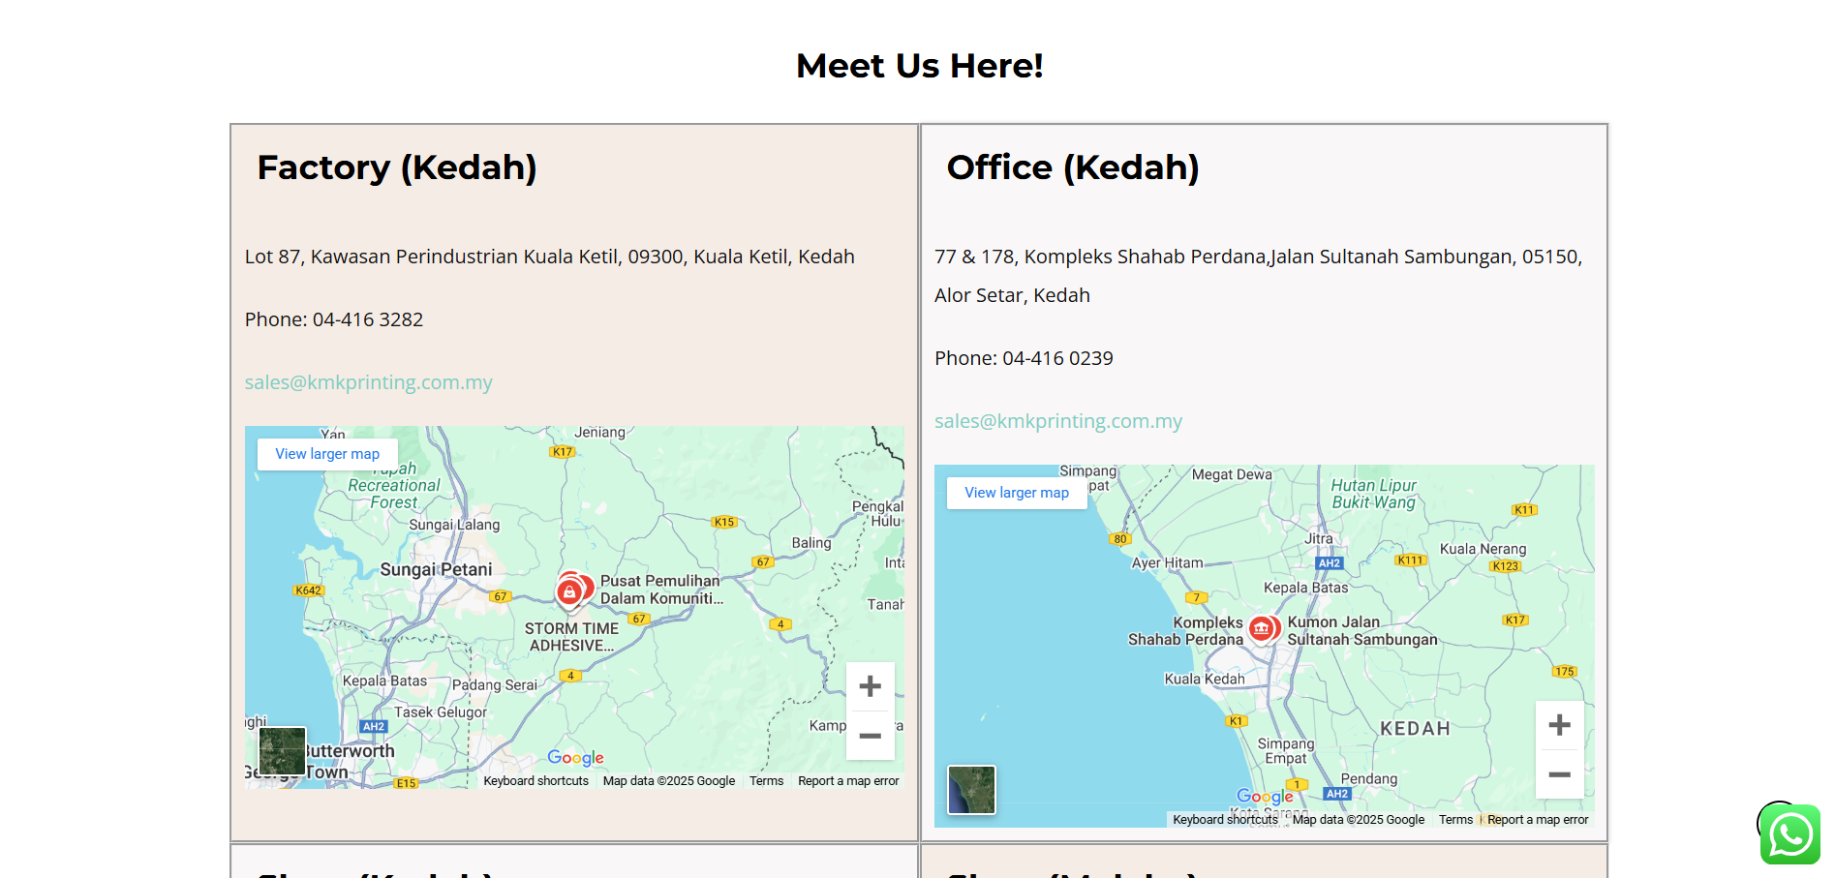
MAPS

Slide 12
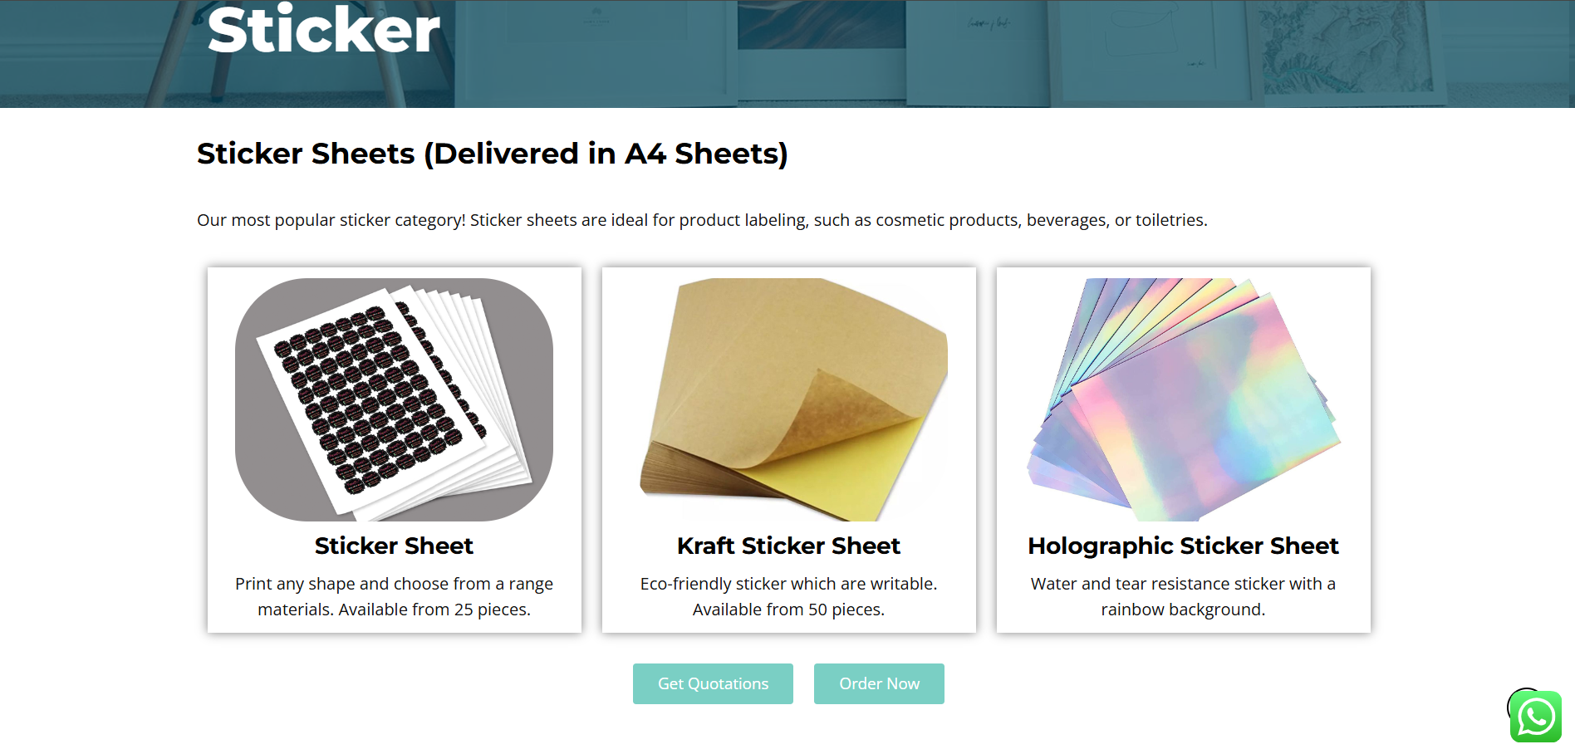
ITEM DETAILS

Slide 13
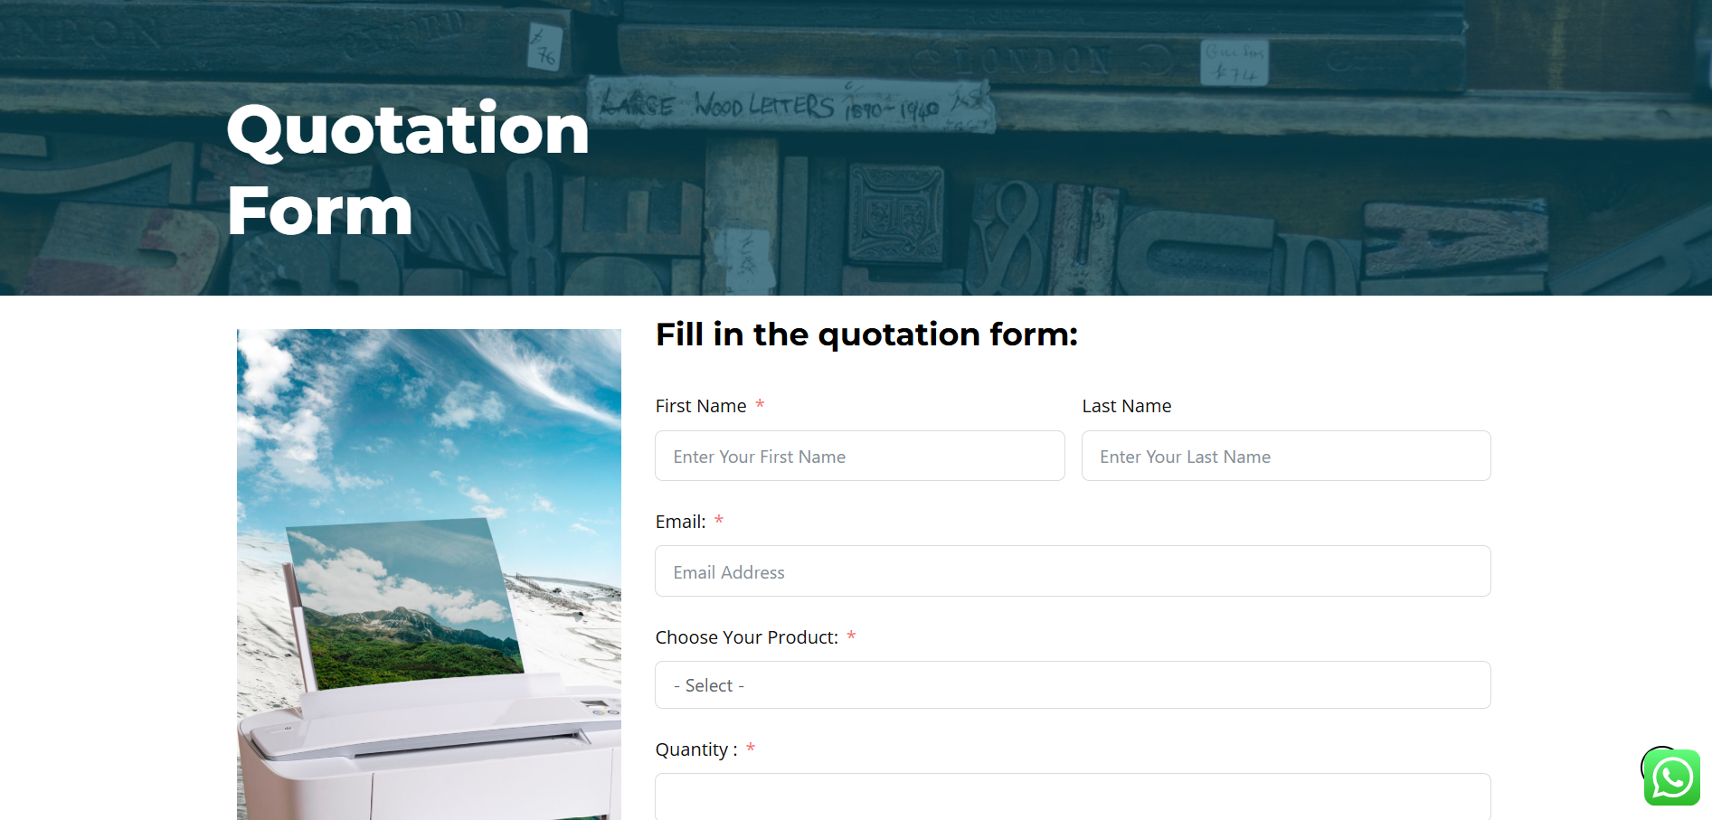
QUOTATION FORM

Slide 14
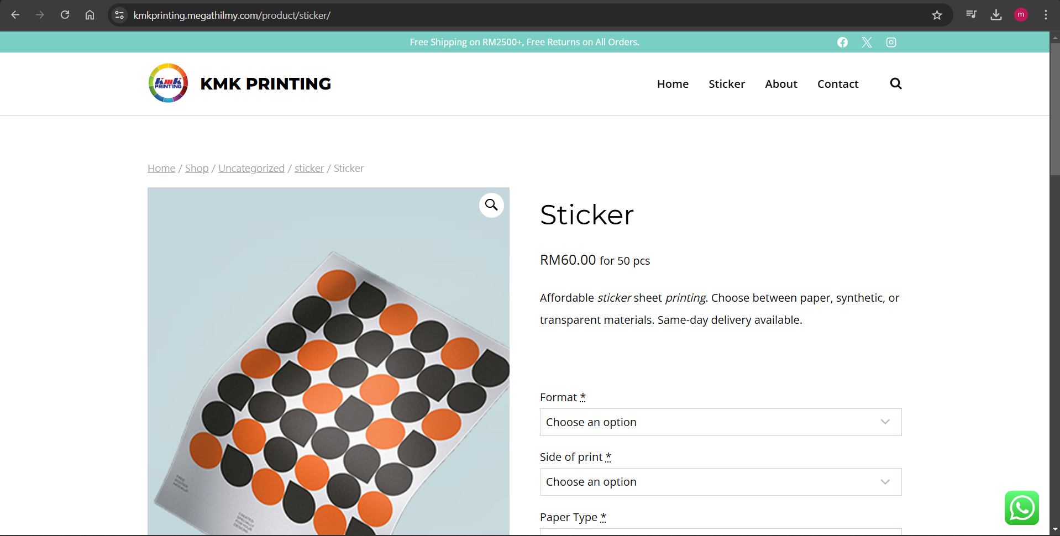
E-COMMERCE

